Slide 1
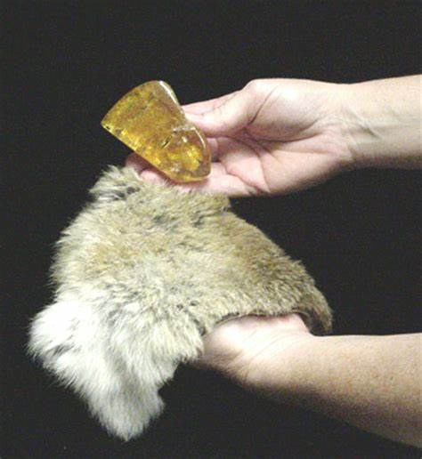
1. Electric Charge 电荷
600 BC - ancient Greek rubbed amber with wool. The amber could attract other objects.
We say that the amber has become charged or has acquired electric charges.
公元前600年古希腊，羊毛摩擦过的琥珀吸引轻小物体
公元1世纪，王充《论衡》：“顿牟掇芥 dùn mó duō gài”
摩擦过的琥珀带有电荷 物体由于摩擦带电
摩擦起电：电子的转移
Notes:
Dun4 mou2 duo1 gai4

Slide 2
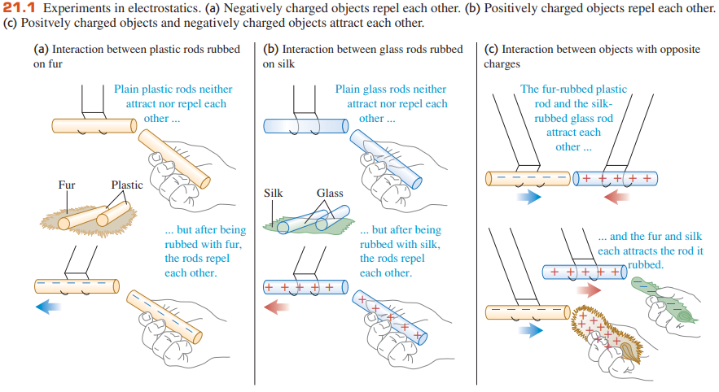
1. Positive & negative charges, charging objects by friction
Glass rods rubbed on silk (+) acetate rubbed with cloth (+)
Plastic rods rubbed on fur (-) polythene rubbed with cloth (-)
Like charges repel (+ and +, or - and -), while unlike charges attract (+ and -).
Insulators can be charged by friction
正电荷与负电荷、摩擦起电
丝绸摩擦玻璃棒（失去电子） →棒带正电
毛皮摩擦硬橡胶棒（得到电子） →棒带负电
同种电荷相互排斥，异种电荷相互吸引

Slide 3
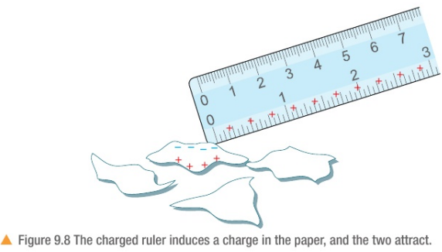
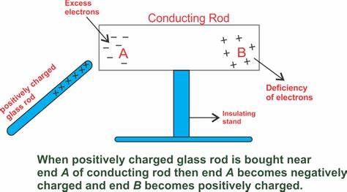
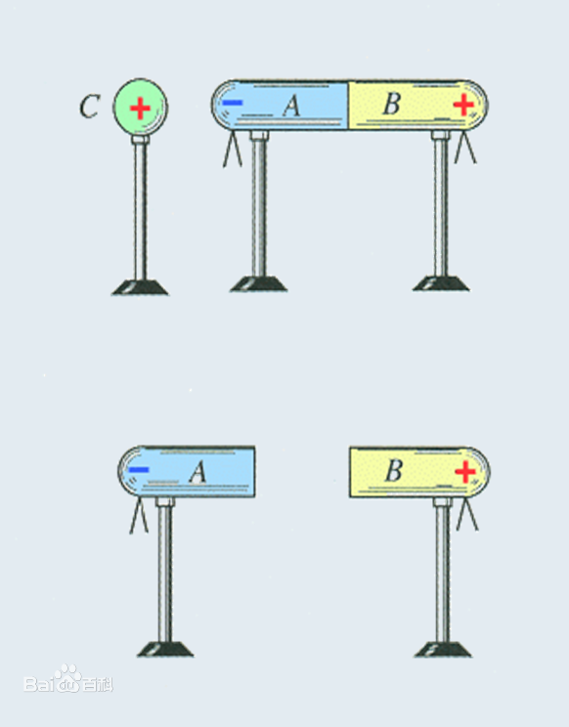
2. Electrostatic induction
Electrostatic induction is the physical phenomenon in which a material can be charged without any actual contact with a charged body.
It is possible for a charged object to attract something that is uncharged.
注：摩擦起电、感应起电都没有创造电荷，只是电荷的分布发生了变化/电荷发生了转移。
大量实验事实表明电荷守恒。
Notes:
当一个带电体靠近导体时，由于电荷间相互吸引或排 斥，导体中的自由电荷便会趋向或远离带电体，使导体靠 近带电体的一端带异种电荷，远离带电体的一端带同种电荷。这种现象叫作静电感应。
利用静电感应使金属导体带电的过程叫作感应起电。

Slide 4
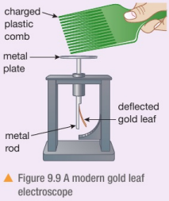
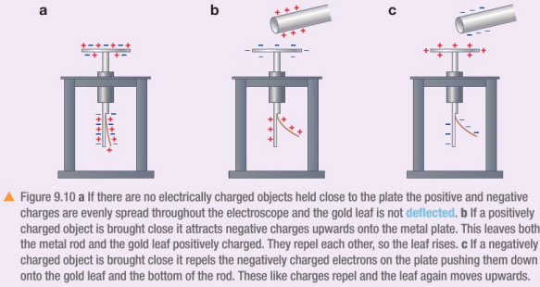
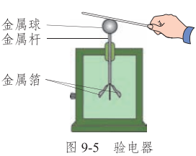
Gold Leaf Electroscope: used for detecting charge
验电器：检验物体是否带电

Slide 5
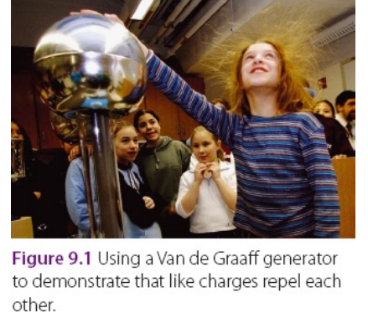
Van de Graaff generator

Slide 6
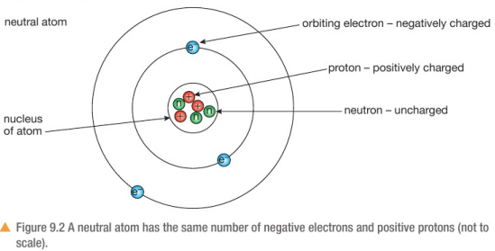
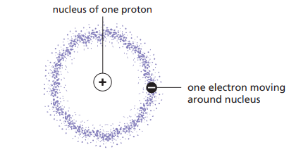
3. Structure of an atom 原子结构
A hydrogen (氢, H) atom has a nucleus of one proton 质子 and one electron 电子 around nucleus.
Every nucleus except hydrogen also contains uncharged particles called neutrons 中子.
Hydrogen is the simplest atom.
A neutral atom has the same number of negative electrons and positive protons.

Slide 7
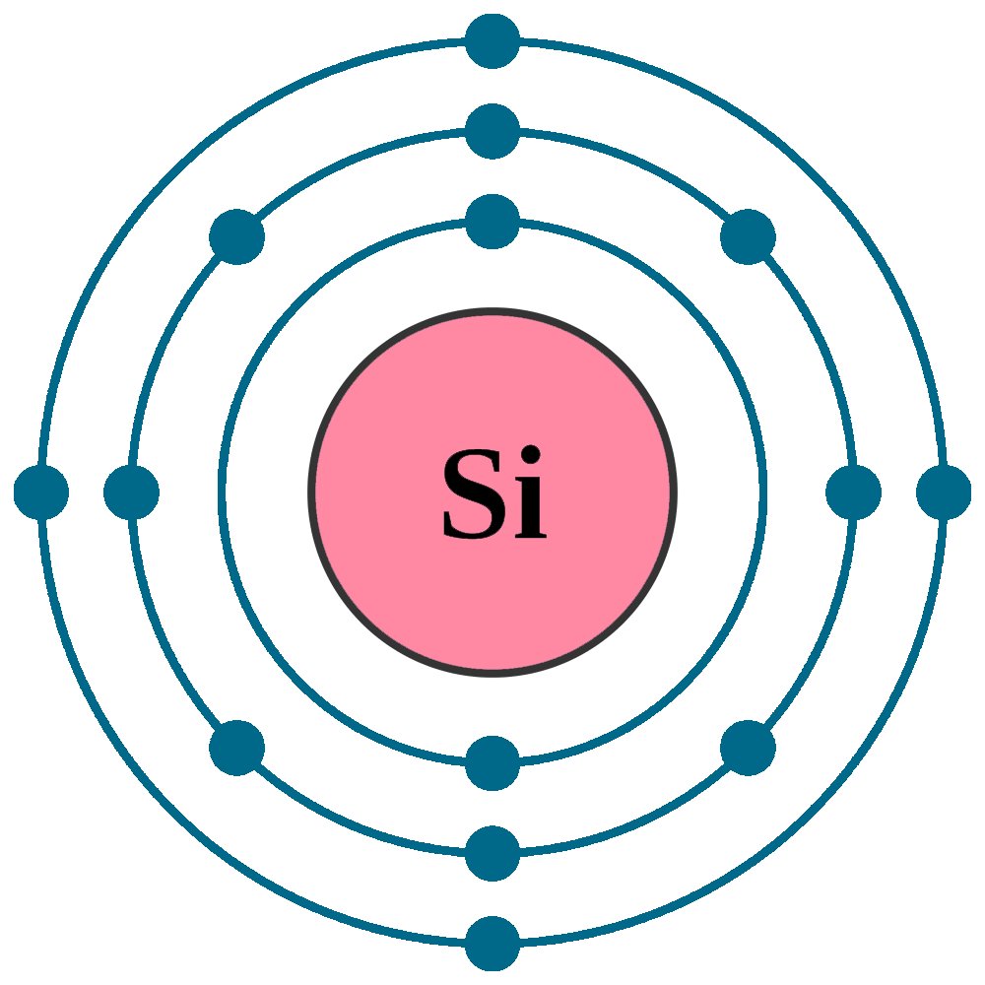
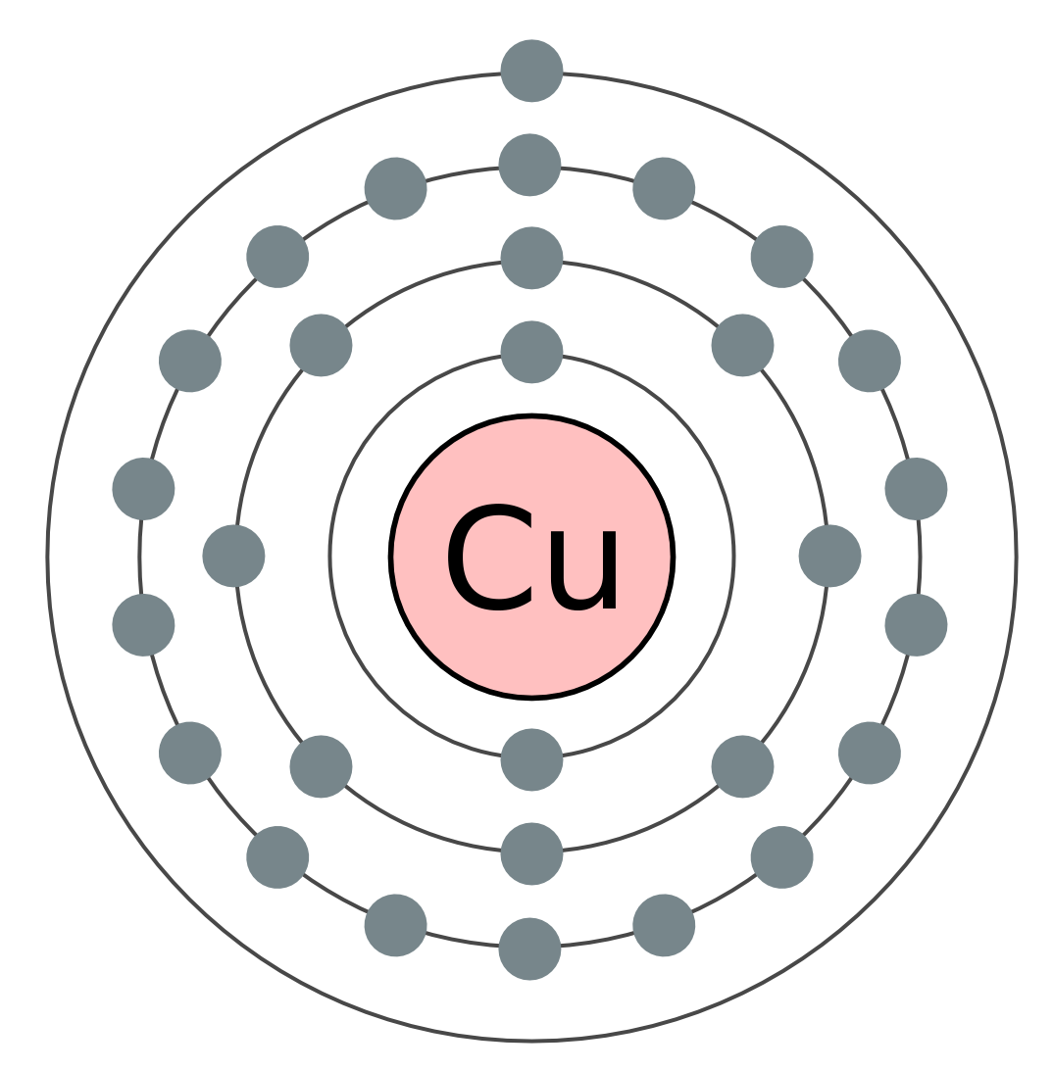
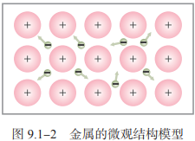
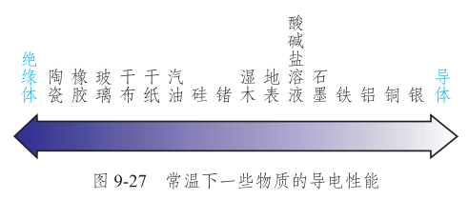
4. Conductors & insulators
Conductors 导体: Materials that conduct electricity well. Insulators 绝缘体: materials that do not conduct electricity at all.
Good conductors: all metals, carbon
Poor conductors/poor insulators: wood, paper, cotton, human body, earth
Good insulators: polythene聚乙烯, cellulose acetate醋酸纤维素, Perspex有机玻璃, nylon, pure water, dry air
导体与绝缘体
导体：容易导电的物体。 如：金属、大地、石墨、人体、酸碱盐的水溶液等。
导体中有大量的自由电荷 free charges： 金属：自由电子 酸碱盐溶液：正、负离子
绝缘体：不容易导电的物体。 如：橡胶、玻璃、陶瓷、塑料、油、干木棒、干燥空气、纯水。
绝缘体中能够自由移动的电荷太少
实验表明，导体和绝缘体并没有绝对的界限
Notes:
纯水是绝缘体，生活中的水由于溶有酸、碱或盐，一般是导体
干燥空气是绝缘体，夏天打雷打闪时云层之间的空气是导体
实验表明，导体和绝缘体并没有绝对的界限

Slide 8
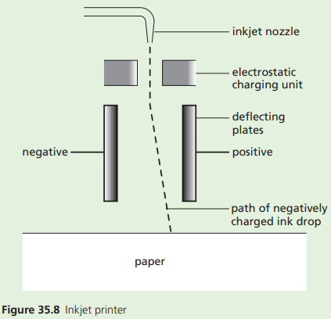
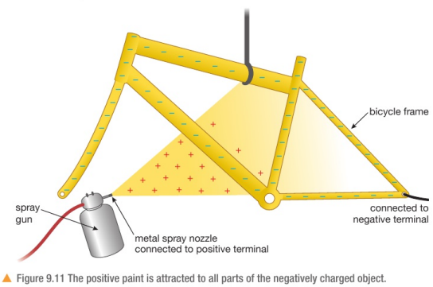
5.1. Uses of static electricity 静电现象的应用
1. Electrostatic paint spraying 静电喷涂
2. Inkjet printers 喷墨打印机

Slide 9
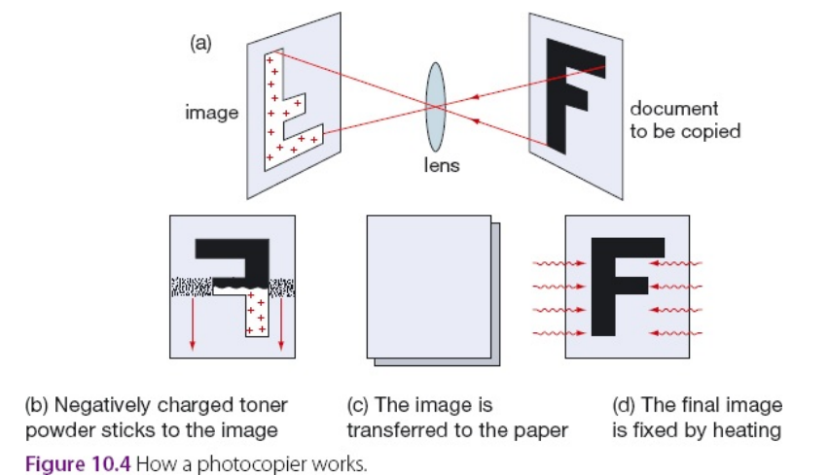
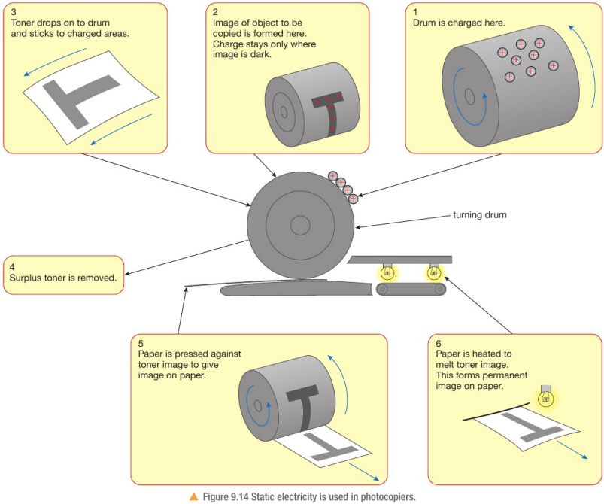
3. Photocopiers 复印机
The key to photocopying is a plate that is affected by light. When the plate is in the dark its surface is positively charged. When the plate is in the light it is uncharged.
An image of the document to be copied is projected on to the plate (Figure 10.4(a)). The dark parts of the plate become charged.
Now the plate is covered with a dark powder, called toner. The particles in the toner have been negatively charged (Figure 10.4(b)), so the toner sticks to the dark parts of the plate, leaving a dark image.
Next, a piece of paper is pressed on to the plate. This paper is positively charged, so the toner is attracted to it (Figure 10.4(c)).
Finally, the paper is heated. The toner melts and sticks to the paper, making the photocopy of the document (Figure 10.4(d)).
Notes:
These contain a charged drum and when the paper to be copied is laid on the glass plate, the light reflected from the white parts of the paper causes the charge to disappear from the corresponding parts of the drum opposite. The charge pattern remaining on the drum corresponds to the dark coloured printing on the original. Special toner powder is then dusted over the drum and sticks to those parts which are still charged. When a sheet of paper passes over the drum, the particles of toner are attracted to it and fused into place by a short burst of heat.

Slide 10
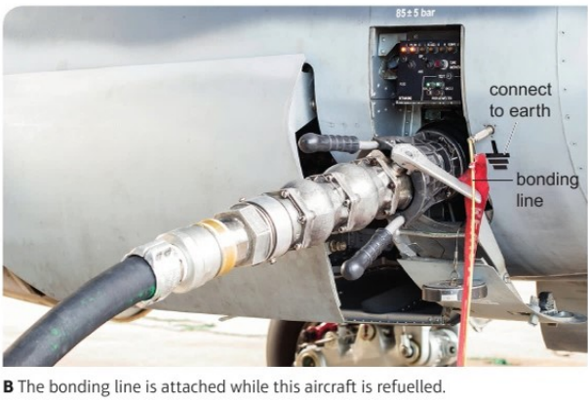
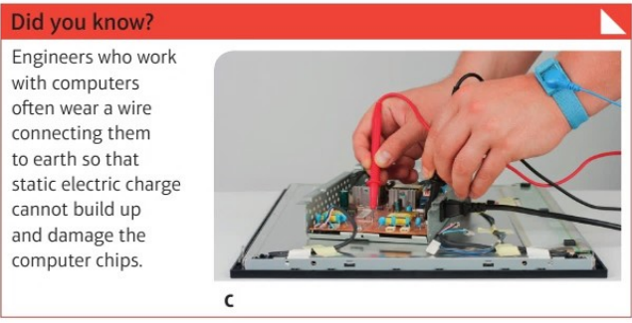
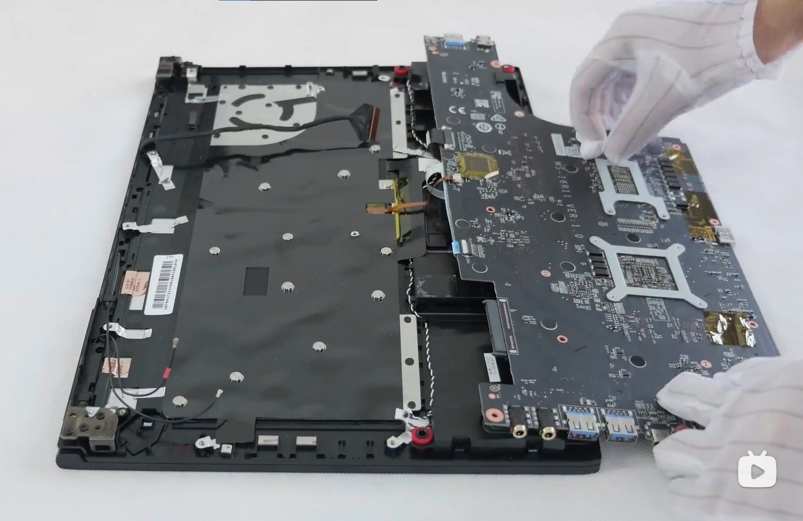
5.2. Problems with static electricity 静电现象的危害与防护
Refueling
接地 Earthing
Computers & Engineers who work with computers

Slide 11
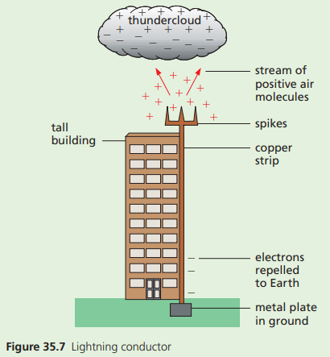
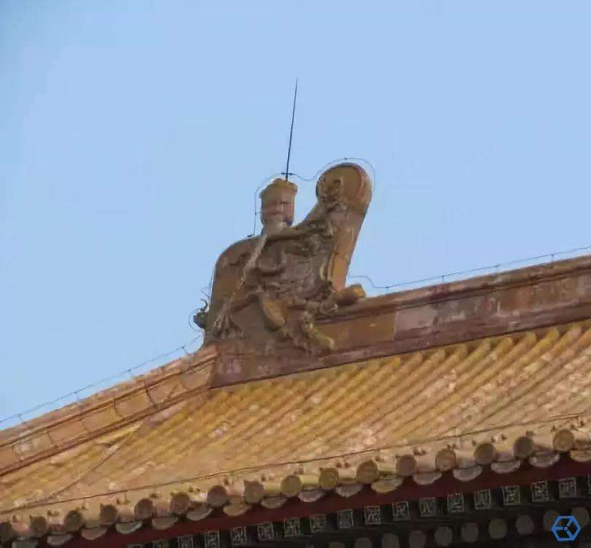
5.2. Problems with static electricity 静电现象的危害与防护
Lightning
用避雷针 use lightning conductor

Slide 12
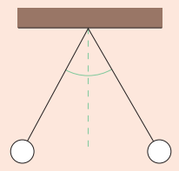
一般情况下，下列各组物质，全部属于导体的是
硬币、蒸馏水、铅笔芯、干木棒
橡皮、玻璃球、食用油、轮胎
铁丝、空气、人体、盐酸溶液
铜丝、盐水、大地、铅笔芯
用带正电的物体去靠近一个吊在细线上的草球，发现小草球被带电体吸引过来了，说明这个小草球带负电？
Two identical conducting balls, suspended on nylon threads, come to rest with the threads making equal angles with the vertical, as shown in Figure. Which of these statements is true? This shows that:
the balls are equally and oppositely charged
the balls are oppositely charged but not necessarily equally charged
one ball is charged and the other is uncharged
the balls both carry the same type of charge
one is charged and the other may or may not be charged.
Notes:
D, 不对！也可能不带电。感应起电, D

Slide 13
Explain in terms of electron movement what happens when a polythene rod becomes charged negatively by being rubbed with a cloth.
Which of statements A to E is true? In the process of electrostatic induction,
a conductor is rubbed with an insulator
a charge is produced by friction
negative and positive charges are separated
a positive charge induces a positive charge
electrons are ‘sprayed’ into an object.
Notes:
Electrons are transferred from the cloth to the polythene. C

Slide 14
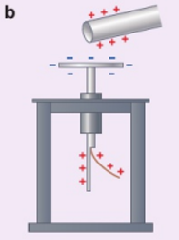
Summary 总结：
Glass rod rubbed on silk has positive charges Plastic rod rubbed on fur has negative charges
Like charges repel, unlike charges attract
Objects repel each other: have like charges
Objects attract each other: have unlike charges OR one is charged and the other is uncharged (by electrostatic induction)
Objects can be charged by friction (insulators), contact (conductors), and induction
Electrons (e⁻) are the charge carrier in metals.

Slide 15
References:
北师大版初中物理（北京）九年级
T. Duncan, H. Kennett, Cambridge IGCSE Physics (3rd Ed.)
N. England, Edexcel IGCSE (9-1) Physics (2nd Ed.)
H. Young & R. Freedman, University Physics (13th Ed.)

